Slide 1
Introduction to Jupyter Notebooks with Microsoft Azure Bogdan Mocanu bogdan_costel.mocanu@upb.ro

Slide 2
1.
DATA SCIENCE AN INTRODUCTION
Introduction to Big Data

Slide 3
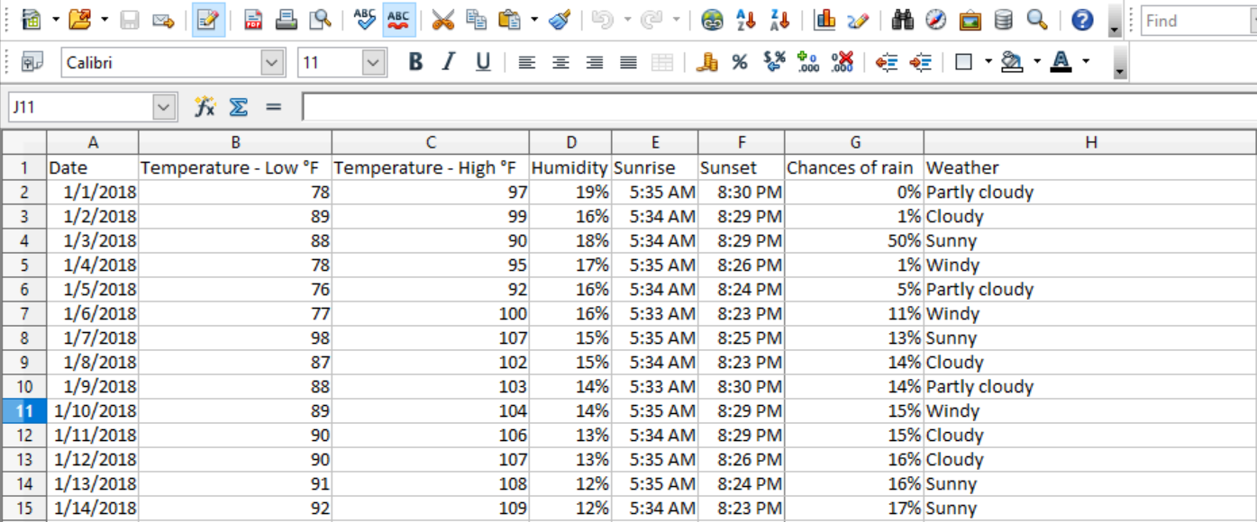

DATA SCIENCE TERMS
A dataset is a table/spreadsheet document with historical information
If you want to understand details about the weather, the dataset will include the historical information about the weather in the past few years. Precipitation, Humidity, Temperature, etc.
Sample snapshot of the dataset
Introduction to Big Data

Slide 4
DATA SCIENCE TERMS (cont.)
A variable is like a container that can be assigned a value.
Precipitation, Humidity, temperature etc are variables in the previous example.
Types of variables​:
Independent variables are not influenced by any factors and impact the outcome variable. The outcome variable is ‘chances of rain’. Temperature, Humidity, sunrise, sunset times are independent variables.
Dependent variables are influenced or dependent on the independent variable. For example – the chance of rain depends on the temperature, humidity etc. Depending on the temperature, the chances of rain may increase or decrease.
Any variable with numerical value is considered as continuous. Temperature, humidity, and chances of rain are considered continuous variables.
Any variable with non-numerical value is considered as categorical. Weather is considered a categorical variable.
Descriptive data​: Summarize the data or describe the data in a meaningful way to provide insights about the dataset. Below are some of the key insights that can be provided to describe the data:
Highest and lowest temperature
Did increase in the temperature lower the chances of rain?
Effects of humidity on rain
Weather Vs. chances of rain
Introduction to Big Data

Slide 5

DATA SCIENCE PROJECT
1. Importing the Dataset​
We will learn how to import the data set and load it onto the Jupyter Notebook
2. Reviewing the Dataset​
We can review the dataset by looking at the first few rows of data. You can do that by using the head function in python. It helps provide an idea about the data structure.
Introduction to Big Data

Slide 6
2.
Reproductible science

Slide 7
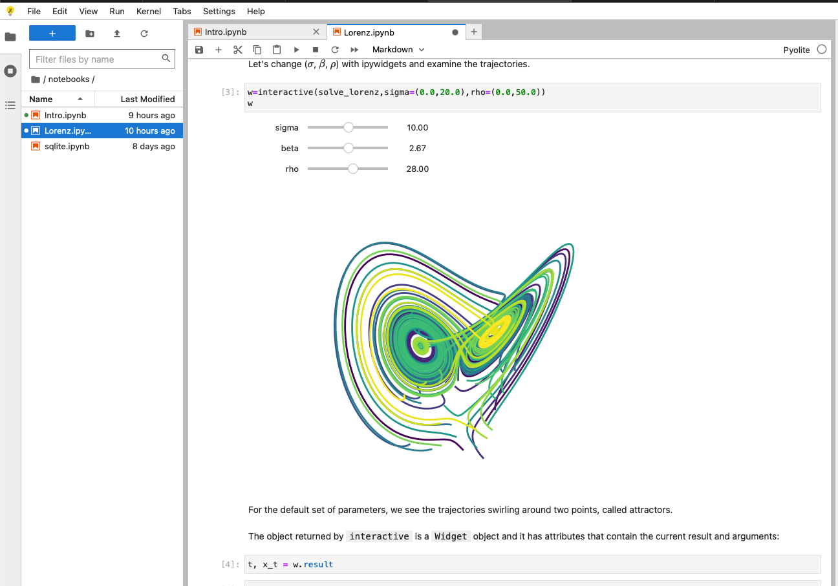

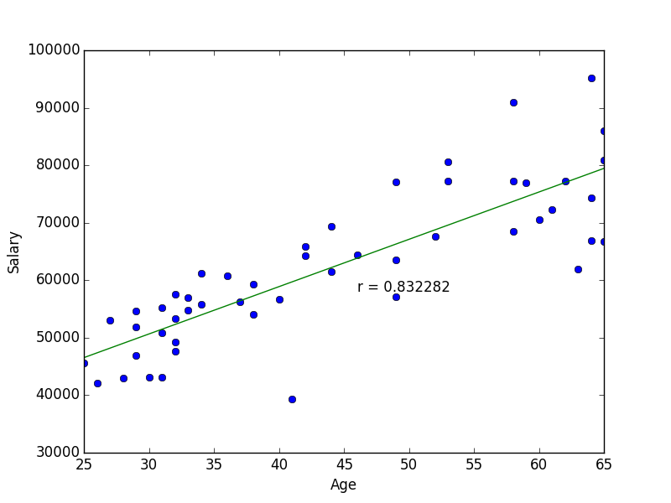
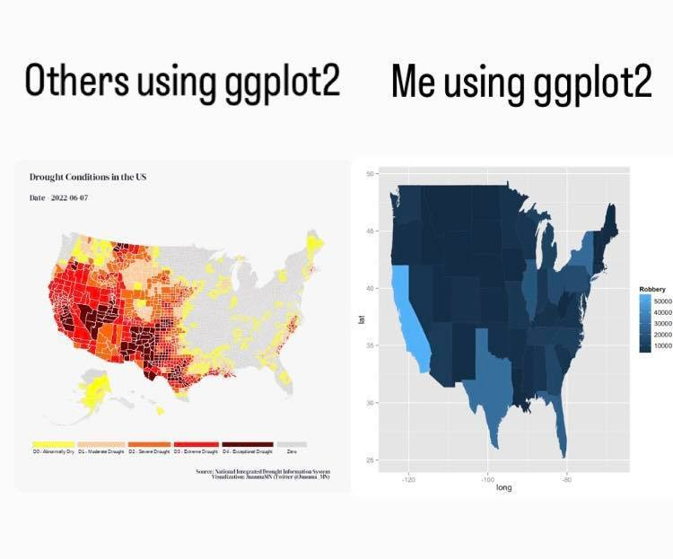
WHY ?

Slide 8
WHAT ?
Jupyter & Reproduceable Research
Jupyter Notebooks
Docker-ized environments
Living laboratories
Data science
Data visualization
Data processing (Big Data)
Advanced applications
E.g. satellite imagery

Slide 9
What is a reproduceable experiment?
In general
Retake
Code
Run
Extend
Modified input data
Modify
Compile
Reused
Modify the logic

Slide 10
3.
JUPYTER NOTEBOOKS

Slide 11
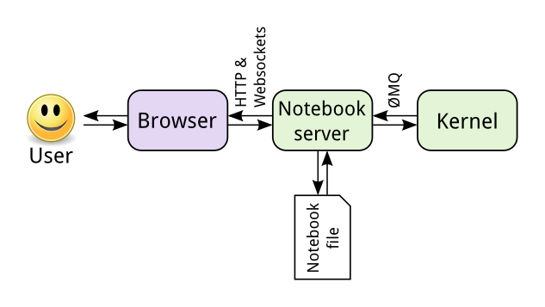
Jupyter arhitecture

Slide 12
JUPYTER NOTEBOOK
A notebook integrates code and its output into a single document that combines visualizations, narrative text, mathematical equations, and other rich media
It is a single document where you can run code, display the output, and also add explanations, formulas, charts, and make your work more transparent, understandable, repeatable, and shareable.
Using Notebooks is now a major part of the data science workflow at companies across the globe
A Notebook will speed up your workflow and make it easier to communicate and share your results.
Jupyter Notebook is an incredibly powerful tool for interactively developing and presenting data science projects
As part of the open source Project Jupyter, Jupyter Notebooks are completely free.
You can download the software on its own, or as part of the Anaconda data science toolkit.

Slide 13
INSTALING JUPYTER NOTEBOOK
The easiest way for a beginner to get started with Jupyter Notebooks is by installing Anaconda.
Anaconda is the most widely used Python distribution for data science and comes pre-loaded with all the most popular libraries and tools.
Some of the biggest Python libraries included in Anaconda include NumPy, pandas, and Matplotlib, though the full 1000+ list is exhaustive.
To get Anaconda, simply:
Download the latest version of Anaconda for Python 3.8.
Install Anaconda by following the instructions on the download page and/or in the executable.
If you are a more advanced user with Python already installed and prefer to manage your packages manually, you can just use pip:
pip3 install jupyter

Slide 14
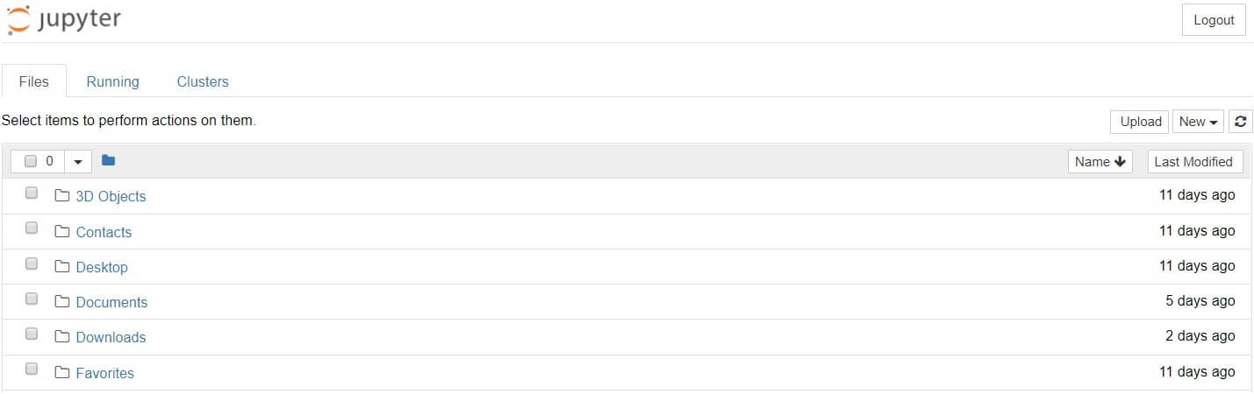
RUNNING JUPYTER NOTEBOOK
One can run Jupyter via the shortcut Anaconda adds to your start menu, or via ‘Jupyter notebook’, which will open a new tab in your default web browser:
This isn’t a notebook just yet, but don’t panic! There’s not much to it. This is the Notebook Dashboard, specifically designed for managing your Jupyter Notebooks. Think of it as the launchpad for exploring, editing and creating your notebooks.

Slide 15
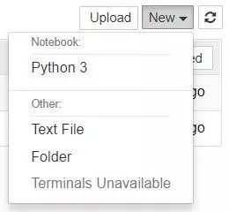
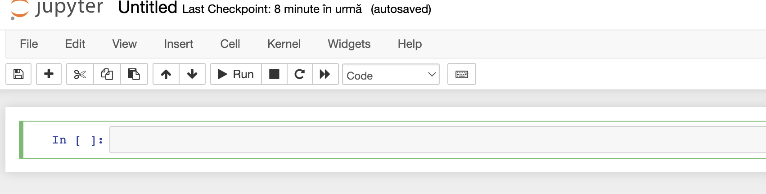
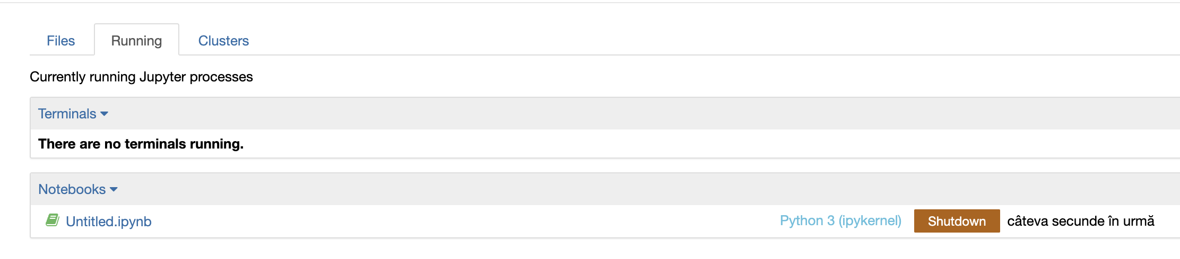
JUPYTER NOTEBOOK
Jupyter’s Notebooks and dashboard are web apps, and Jupyter starts up a local Python server to serve these apps to your web browser, making it essentially platform-independent and opening the door to easier sharing on the web.
Browse to the folder in which you would like to create your first notebook, click the “New” drop-down button in the top-right and select “Python 3”:
Your first Jupyter Notebook will open in new tab — each notebook uses its own tab because you can open multiple notebooks simultaneously.
If you switch back to the dashboard, you will see the new file Untitled.ipynb and you should see some green text that tells you your notebook is running.

Slide 16
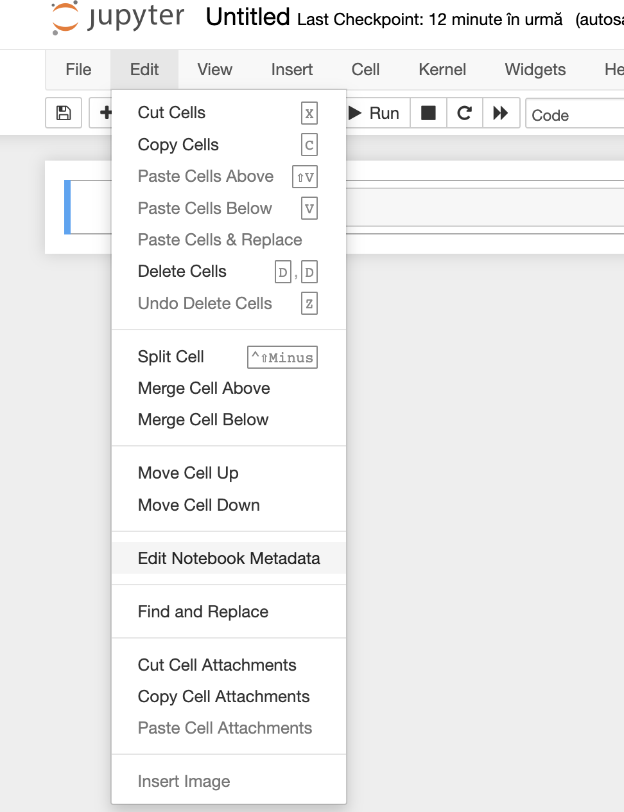
ipynb FILE
Each .ipynb file is one notebook
Each time you create a new notebook, a new .ipynb file will be created.
An .ipynb file is a text file that describes the contents of your notebook in a format called JSON. Each cell and its contents, including image attachments that have been converted into strings of text, is listed therein along with medatadata.
You can edit this yourself — if you know what you are doing! — by selecting “Edit > Edit Notebook Metadata” from the menu bar in the notebook. You can also view the contents of your notebook files by selecting “Edit” from the controls on the dashboard
However, the key word there is can. In most cases, there’s no reason you should ever need to edit your notebook metadata manually.

Slide 17
NOTEBOOK TERMS
There are two Notebook terms that we work with: cells and kernels

Slide 18
NOTEBOOK TERMS
There are two Notebook terms that we work with: cells and kernels
A kernel is a “computational engine” that executes the code contained in a notebook document.

Slide 19
NOTEBOOK TERMS
There are two Notebook terms that we work with: cells and kernels
A kernel is a “computational engine” that executes the code contained in a notebook document.
A cell is a container for text to be displayed in the notebook or code to be executed by the notebook’s kernel

Slide 20
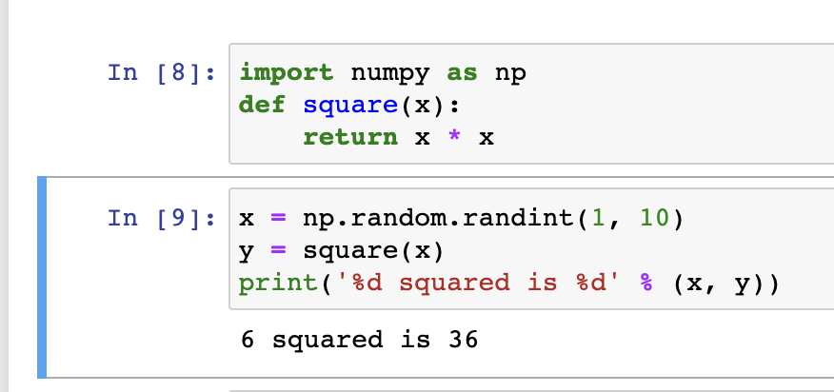
KERNELS
Behind every notebook runs a kernel
When you run a code cell, that code is executed within the kernel.
Any output is returned back to the cell to be displayed.
The kernel’s state persists over time and between cells — it pertains to the document as a whole and not individual cells.
For example, if you import libraries or declare variables in one cell, they will be available in another. Let’s try this out to get a feel for it:

Slide 21
CHOOSING A KERNEL
You may have noticed that Jupyter gives you the option to change kernel, and in fact there are many different options to choose from.
Back when you created a new notebook from the dashboard by selecting a Python version, you were actually choosing which kernel to use.
There kernels for different versions of Python, and also for over 100 languages including Java, C, and even Fortran.
Data scientists may be particularly interested in the kernels for R and Julia, as well as both imatlab and the Calysto MATLAB Kernel for Matlab.
The SoS kernel provides multi-language support within a single notebook.

Slide 22
CELLS
Cells form the body of a notebook.
There are two main cell types :
A code cell contains code to be executed in the kernel.
When the code is run, the notebook displays the output below the code cell that generated it.
The first cell in a new notebook is always a code cell.
A Markdown cell contains text formatted using Markdown and displays its output in-place when the Markdown cell is run.
Let’s test it out with a classic hello world example:
Type print('Hello World!') into the cell and click the run button Notebook Run Button in the toolbar above or press Ctrl (or CMD) + Enter.

Slide 23

CELLS (cont.)
Notice the difference? When we run the cell, its output is displayed below and the label to its left will have changed from In [ ] to In [1]
The “In” part of the label is simply short for “Input,” while the label number indicates when the cell was executed on the kernel — in this case the cell was executed first.
Run the cell again and the label will change to In [2] because now the cell was the second to be run on the kernel.
The output of a code cell also forms part of the document
You can always tell the difference between code and Markdown cells because code cells have that label on the left and Markdown cells do not.

Slide 24
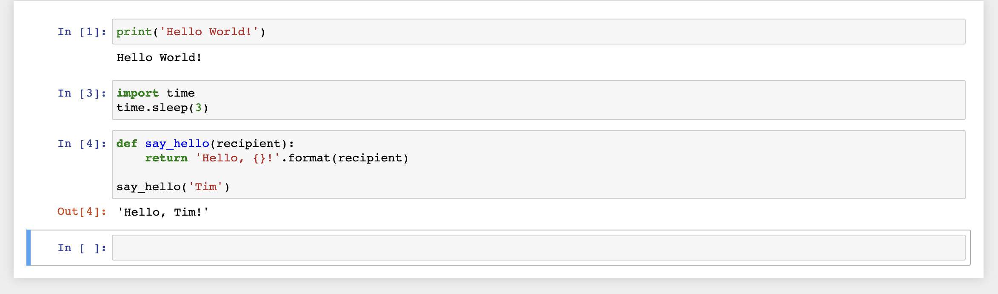
CELLS (cont.)
In general, the output of a cell comes from any text data specifically printed during the cell’s execution, as well as the value of the last line in the cell, be it a lone variable, a function call, or something else.

Slide 25
KEYBOARD SHORTCUTS
One thing you may have observed when running your cells is that their border turns blue, whereas it was green while you were editing.
In a Jupyter Notebook, there is always one “active” cell highlighted with a border whose color denotes its current mode:
Green outline — cell is in “edit mode”
Blue outline — cell is in “command mode”
Keyboard shortcuts are a very popular aspect of the Jupyter environment because they facilitate a speedy cell-based workflow. Many of these are actions you can carry out on the active cell when it’s in command mode.
Scroll up and down your cells with your Up and Down keys.
Press A or B to insert a new cell above or below the active cell.
M will transform the active cell to a Markdown cell.
Y will set the active cell to a code cell.
D + D (D twice) will delete the active cell.
Z will undo cell deletion.
Hold Shift and press Up or Down to select multiple cells at once. With multiple cells selected, Shift + M will merge your selection.
Ctrl + Shift + -, in edit mode, will split the active cell at the cursor.
You can also click and Shift + Click in the margin to the left of your cells to select them.

Slide 26
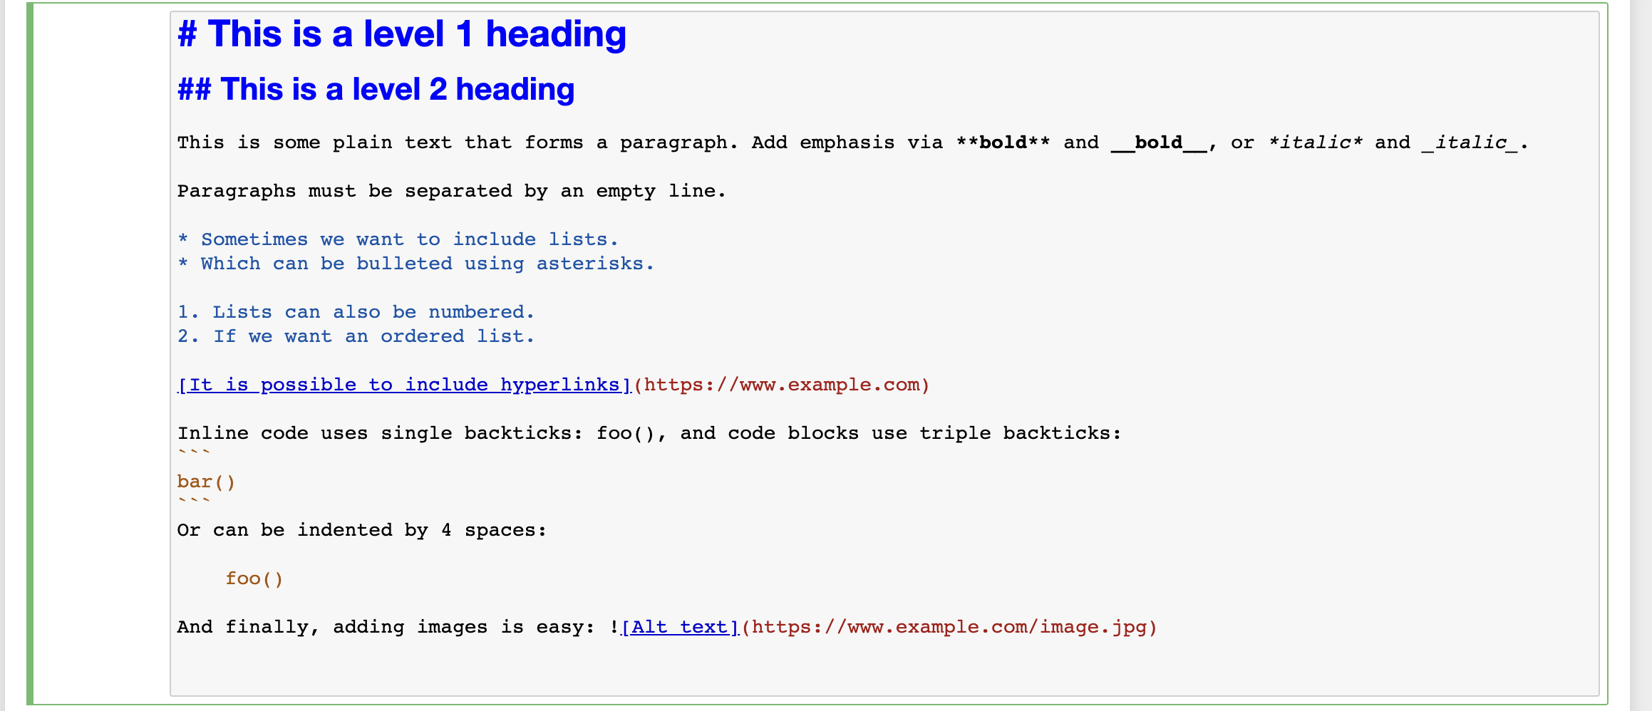
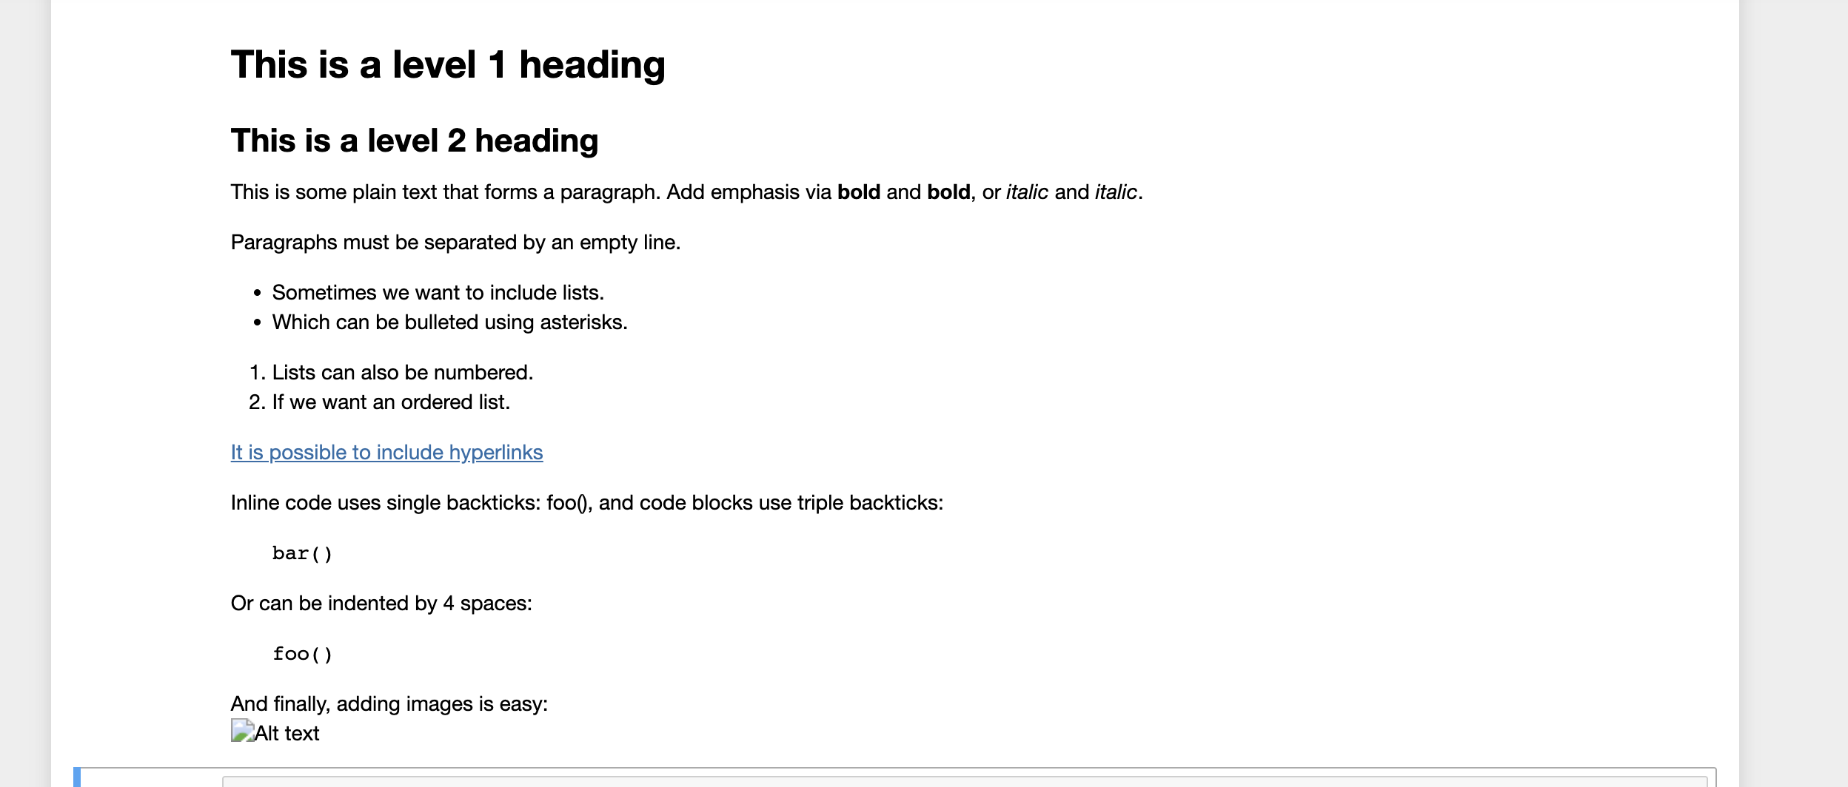
MARKDOWN
Markdown is a lightweight, easy to learn markup language for formatting plain text
Its syntax has a one-to-one correspondence with HTML tags, so some prior knowledge here would be helpful but is definitely not a prerequisite

Slide 27
4.
DEMO. Jupyter Notebook with Microsoft Azure

Slide 28
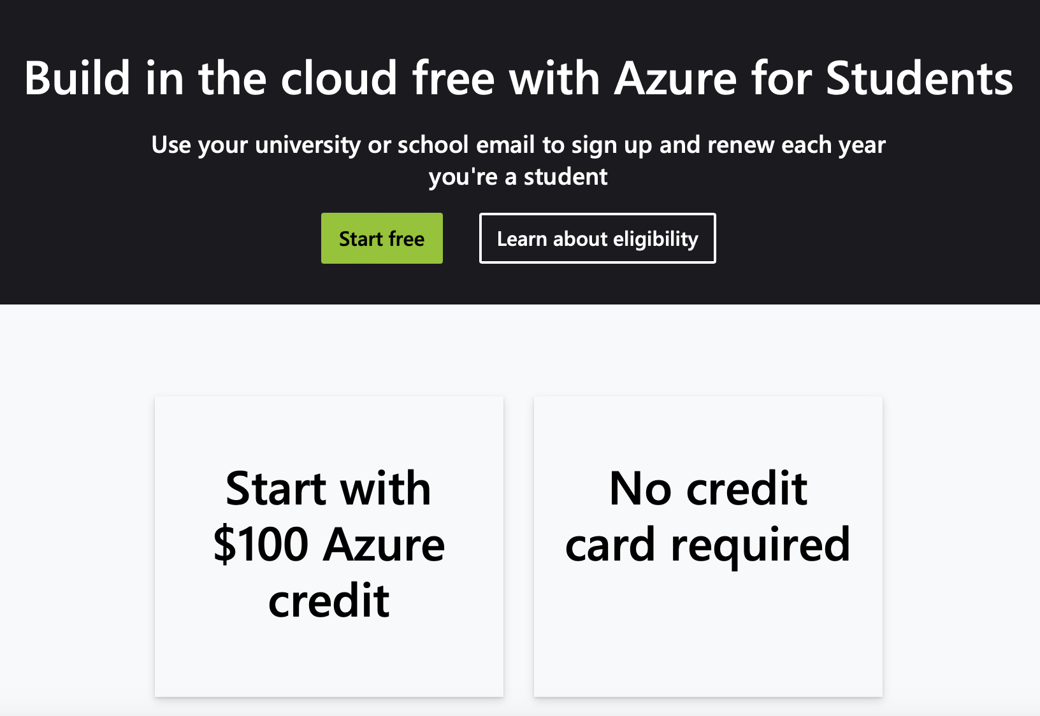
Microsoft Azure setup
https://azure.microsoft.com/en-us/free/students

Slide 29
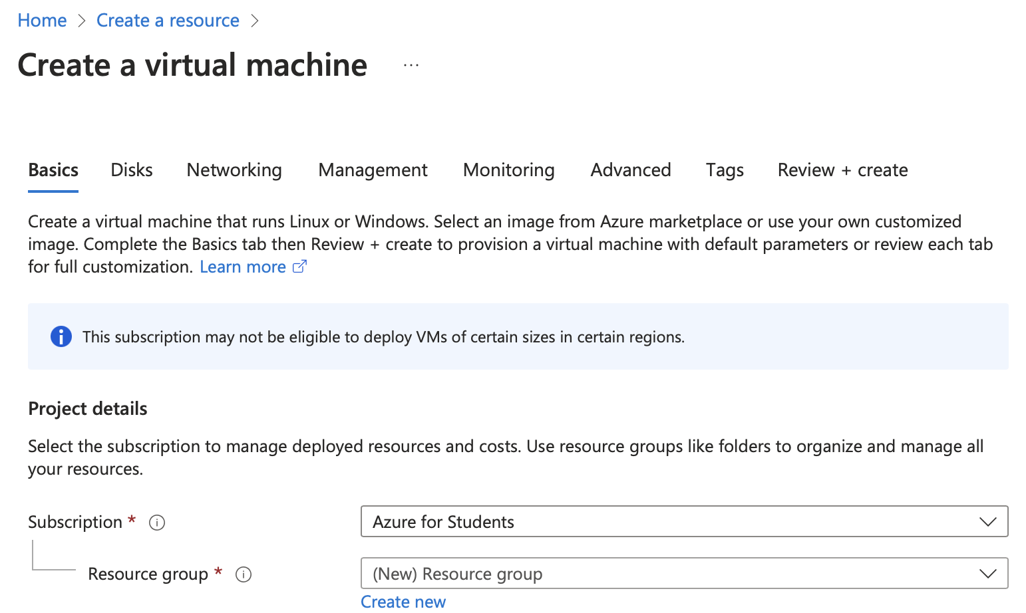
Create a VM in Microsoft Azure
https://azure.microsoft.com/en-us/free/students

Slide 30
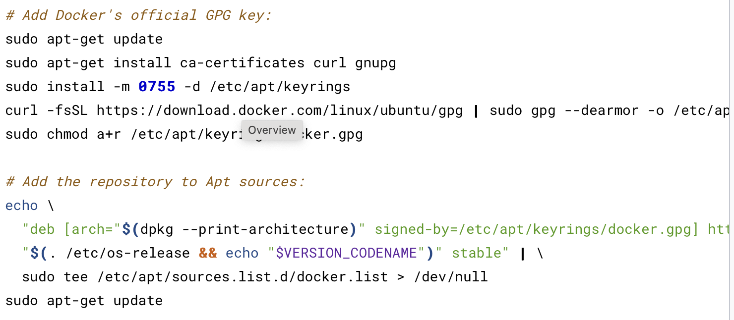
Install requirements for Jupyter with docker
sudo apt-get install docker-ce docker-ce-cli containerd.io docker-buildx-plugin docker-compose-plugin
https://docs.docker.com/engine/install/ubuntu/

Slide 31
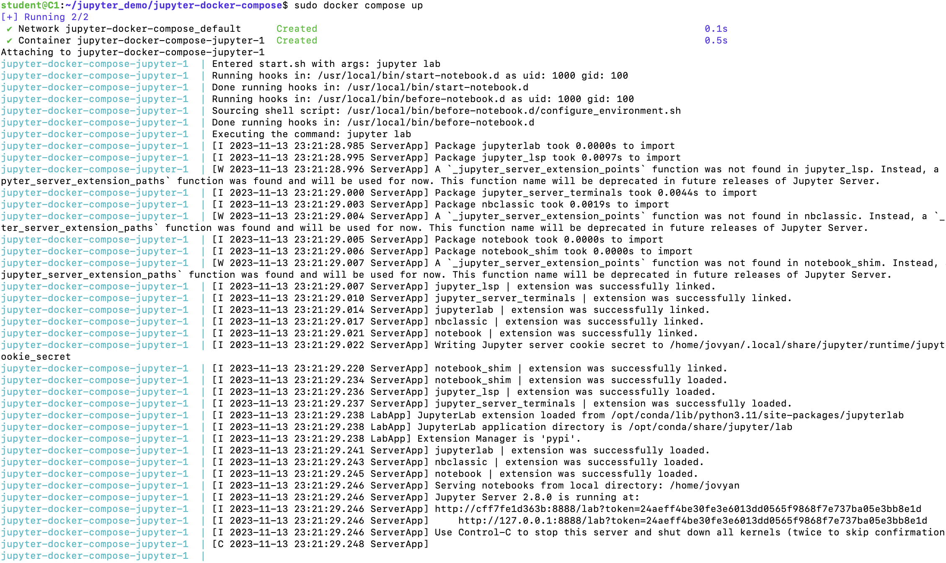
Install Jupyter in Docker
https://github.com/bogdanhpc/Introduction-in-BigData/tree/main/Workshop

Slide 32
Create inbound rule in the VM for port 8888

Slide 33
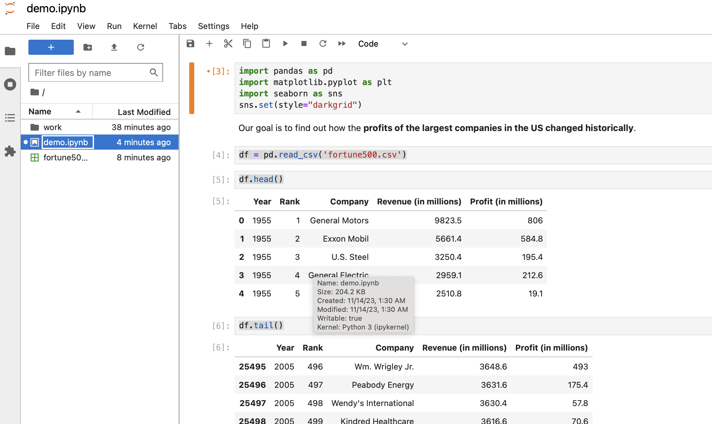
Create inbound rule in the VM for port 8888 & acces http://[publicIP]:8888

